Slide 1
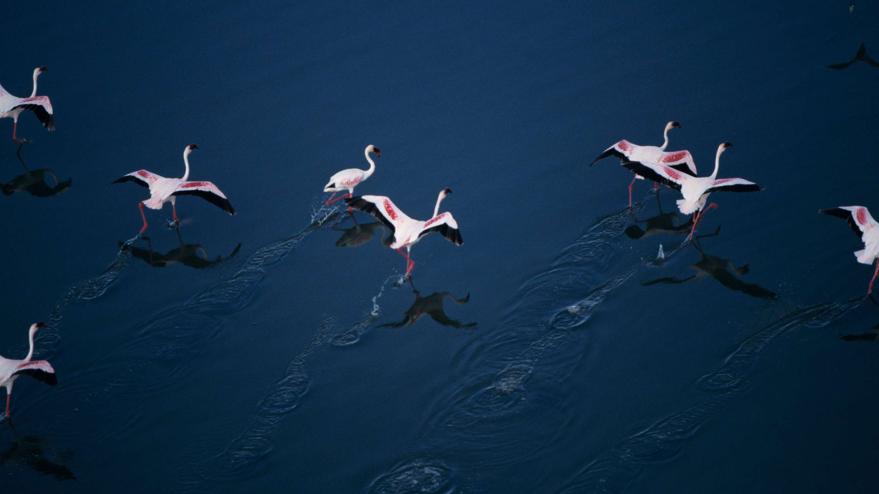

Clause Security

Slide 2
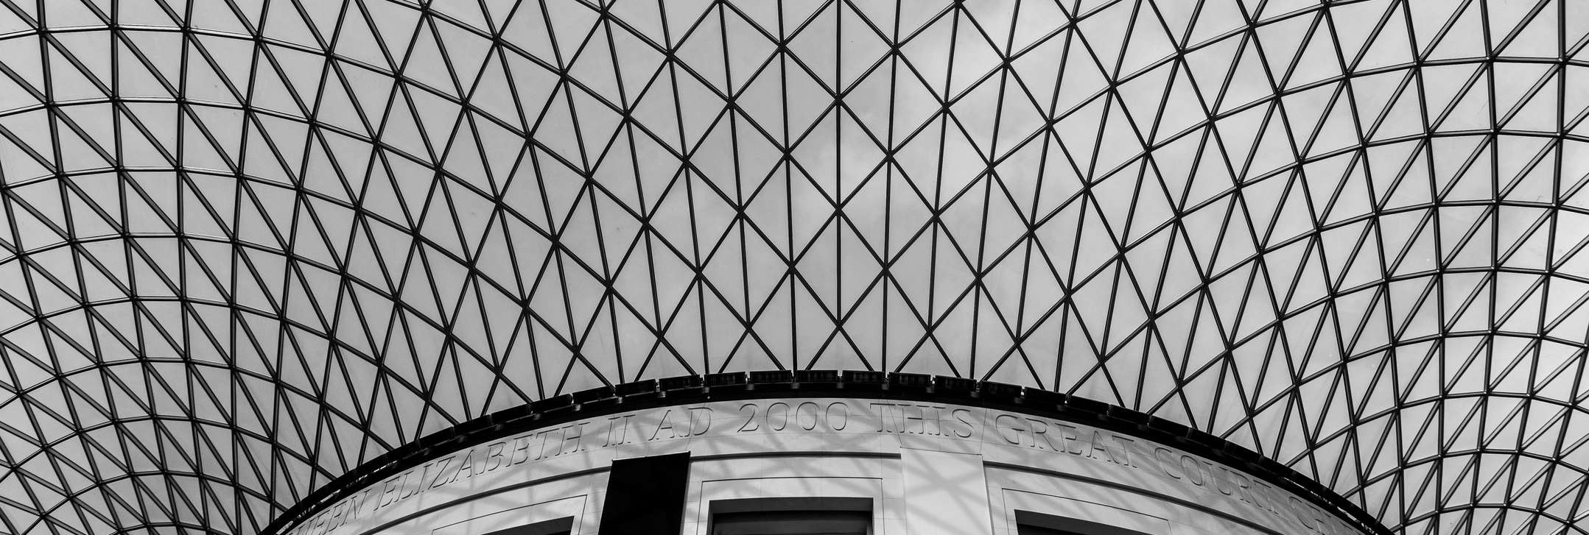
Presentation Agenda
01
02
03
Individual contribution
04
05
06
Aim
Our Team
Solution
References
Code

Slide 3

Aim/Description
Reducing the chances of compromisation of user's credentials and sensitive data.
Creating a safe virtual environment, with exponentially reduced chances of falling victim to cyber crime.
Prevent future attacks on the digital infrastructure

Slide 4


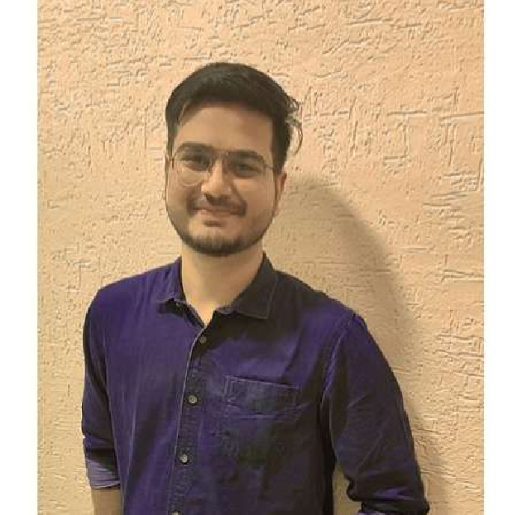
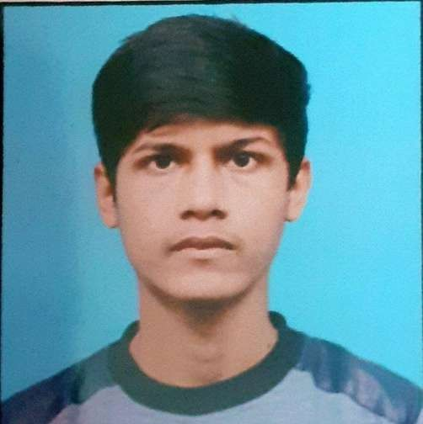
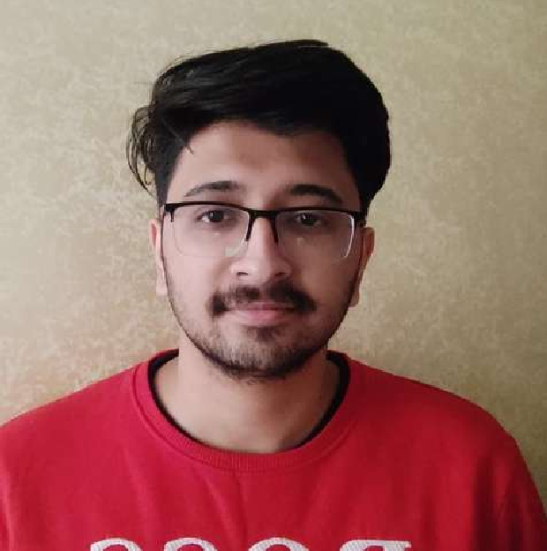
Team- Clause Code
Prince Sharma | Himanshu sharma | Aditya jakhmola
Backend Developer | Front-end Developer | UI/UX Designer
E21CSEU0764 | E21CSEU0761 | E21CSEU0753

Slide 5
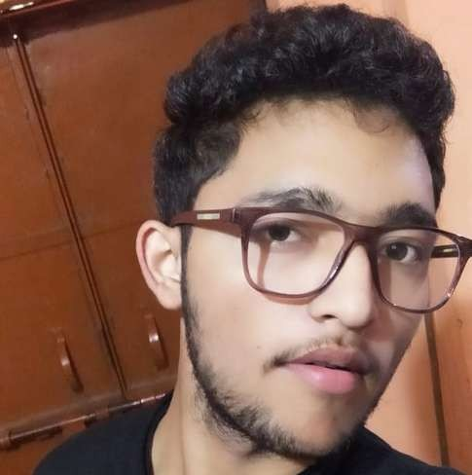

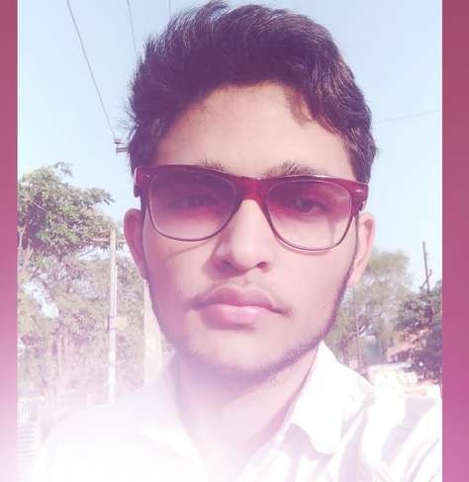
Team- Clause Code
Girendra Sinsinwar
Manan Joshi
Database
E21CSEU0772
Backend Developer
E21CSEU0755

Slide 6

Aditya Jakhmola
Individual Contribution
Prince Sharma
Create source code and is responsible for creating and maintaining technology
Himanshu Sharma
Worked to ensure that the python GUI is working perfectly in the project
Worked as a design thinker, content creater as well as monitoring program
Manan Joshi
Helped in creating code and improve the server, and databases
Girendra Sinsinwar
He analyze the needs and produce an effective database system for the project

Slide 7
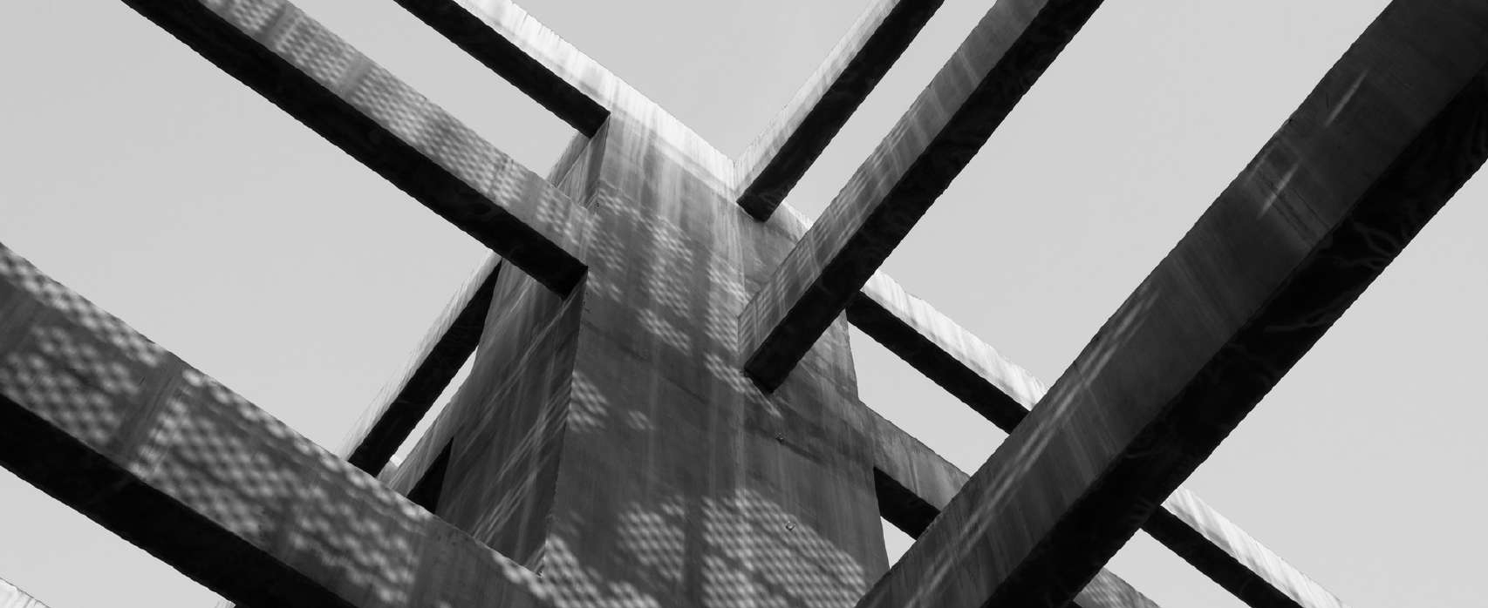
Solution
Every portal requires an user to possess an unique identity limited to them, be it social media or financial portals. Creating an unique identity requires filling in credentials, that would be known only to the user. But due to many users having a lack of imagination, the credentials created by them are thus easy to predict by certain brute forcing scripts, used by cyber criminals. Once they fall victim to cyber crime i.e. in this case, having their credentials exposed, can be a dire situation. This is where our company comes in. Our programme creates additional layer of security by creating a strong and unique captcha which help to terminate automation program of hacking .

Slide 8
References
All the references were taking from the theories from lectures by respected Dr. Jagendra sir, tutorials by Dr. Ajay sir and lab sessions by Dr. Ankit sir
online platforms such as YouTube, Google

Slide 9
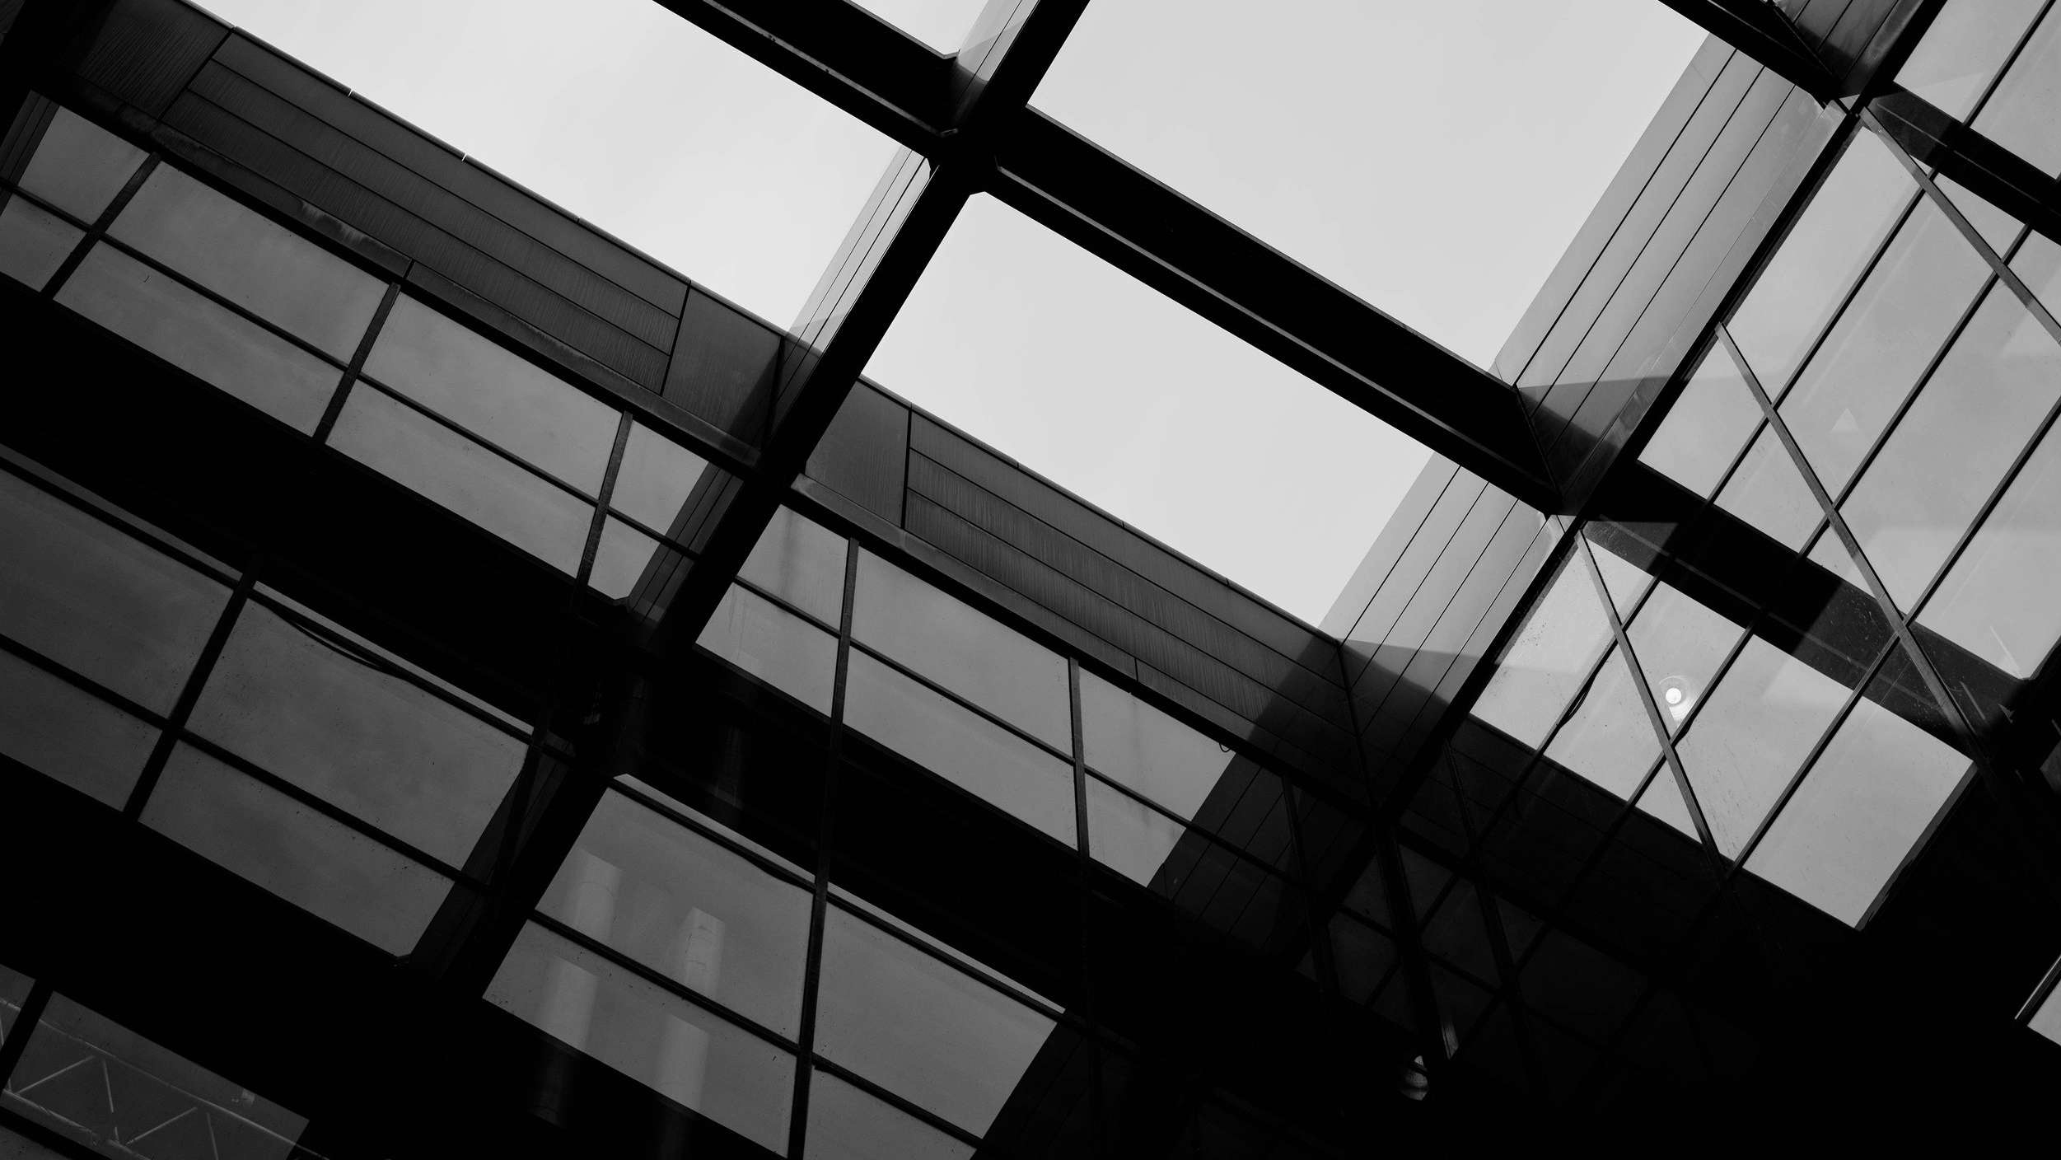

Thank you
We would like to express our great appreciation to Dr. Ankit Jaiswal Sir, Dr Jagendra Singh Sir, Dr Ajay Kumar Sir for their valuable and constructive Lectures. Your willingness to give time so generously has been very much appreciated.

Slide 10


Application- (Code)
import random
# length of captcha can be changed for later use
# declaring max length
MAX_LENGTH = 12
# Declaring variables that we need for our captcha by StringConcatenation
DIGITS = ['0','1','2', '3', '4', '5', '6', '7', '8', '9']
lowerCaseCharacter = ['a', 'b', 'c', 'd', 'e', 'f', 'g', 'h',
'i', 'j', 'k', 'm', 'n', 'o', 'p', 'q',
'r', 's', 't', 'u', 'v', 'w', 'x', 'y','z']
upperCaseCharacter = ['A', 'B', 'C', 'D', 'E', 'F', 'G', 'H',
'I', 'J', 'K', 'M', 'N', 'O', 'p', 'Q',
'R', 'S', 'T', 'U', 'V', 'W', 'X', 'Y','Z']
SYMBOLS = ['@', '#', '$', '%', '=', ':','.', '/', '|', '~', '>','*']
# above list can be changed for later use
#Combining all variables to form a single variable

Slide 11
Application- (Code)
COMBINED_LIST1 = DIGITS + upperCaseCharacter + lowerCaseCharacter + SYMBOLS
# Here used random to randomly select character from all variables
random_digit = random.choice(DIGITS)
random_upper = random.choice(upperCaseCharacter)
random_lower = random.choice(lowerCaseCharacter)
random_symbol = random.choice(SYMBOLS)
# Adding all four variable
temp_passed = random_digit + random_upper + random_lower + random_symbol
# combine every char from above to get captcha
# It is showing a 4 char captcha
# temp_passed will take 4 char from each variable
# As above mentioned we need a 12 char captcha
#--------------------
# to get 8 more char we used forLoop

Slide 12
Application– (Code)
# convert into List
temp_pass_list = list(temp_passed)
for x in range(MAX_LENGTH - 4):
temp_pass_list = temp_pass_list + list(random.choice(COMBINED_LIST1))
# to shuffle Catcha
random.shuffle(temp_pass_list)
# Append the chr
# captcha
CAPTCHA = ""
for x in temp_pass_list:
CAPTCHA = CAPTCHA + x
from graphics import *
win = GraphWin('Captcha', width=500, height=400)
win.setBackground("white")

Slide 13
Application – (Code)
rec = Circle(Point(260,200),20)
rec.setFill("red")
rec.setOutline("black")
rec.setWidth(3)
rec.draw(win)
en = Entry(Point(260,100),width=10)
en.setSize(20)
en.setStyle("bold")
en.setTextColor("white")
en.draw(win)
msg = Text(Point(260,50), "If you are not a robot, Input text.")
msg.draw(win)
msg.setSize(15)
msg.setStyle("bold")
msg.setFill("black")
msg2 = Text(Point(260,250),"Click on above button to get Captcha")
msg2.setSize(15)
msg2.setStyle("bold")
msg2.setFill("green")
msg2.draw(win)
win.getMouse()
if len(en.getText()) !=0:
msg = Text(Point(250,350), "It is your Captcha: {}".format(CAPTCHA))
msg.draw(win)
msg.setSize(15)
msg.setStyle("bold")
msg.setFill("blue")
msg2.setText("Click here to quit program.")
win.getMouse()

